Slide 1


iLink Website & DbOwlizer View Parser
Erick Garcia

Slide 2
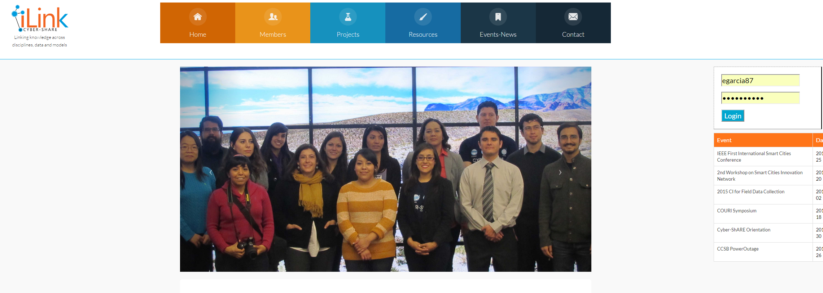
Current iLink Website

Slide 3

New Technologies to be used

Slide 4
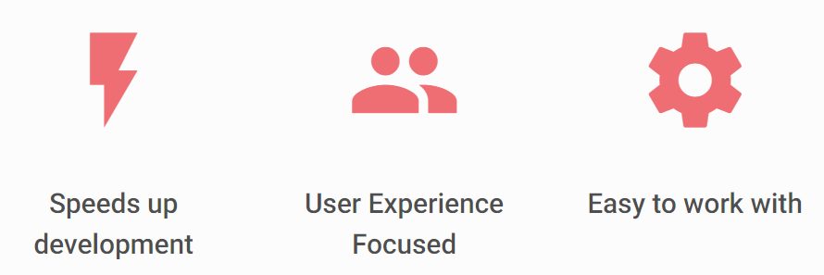
New Technologies to be used
Example 1
Example 2

Slide 5
DbOwlizer Motivation
Current information on the Web is Machine is not machine understandable
Manually designing ontologies is a tedious task (Bottleneck)
Ontologies explicitly describe and relate objects using formal, machine understandable representations

Slide 6
DbOwlizer
A novel framework for the automatic design of expressive ontologies from (normalized) relational databases.
Represent mappings between a relational database and an OWL ontology
Automatically generate such mappings using rule-based heuristics
Execute these mappings to generate a populated OWL ontology.

Slide 7
How DbOwlizer is different from existing approaches
Representing mappings using standardized Semantic Web languages, thereby avoiding the use of application specific non-standard mapping languages
Facilitating the modification and reuse of mapping heuristics
Enabling the comparison of heterogeneous heuristics that map relational databases to ontologies
Automatically generating decidable database-to-ontology mappings for more expressive ontologies
Separating domain knowledge from model knowledge in the output ontology, and
Mapping semantics from database views, including a pattern to characterize aggregation functions.

Slide 8
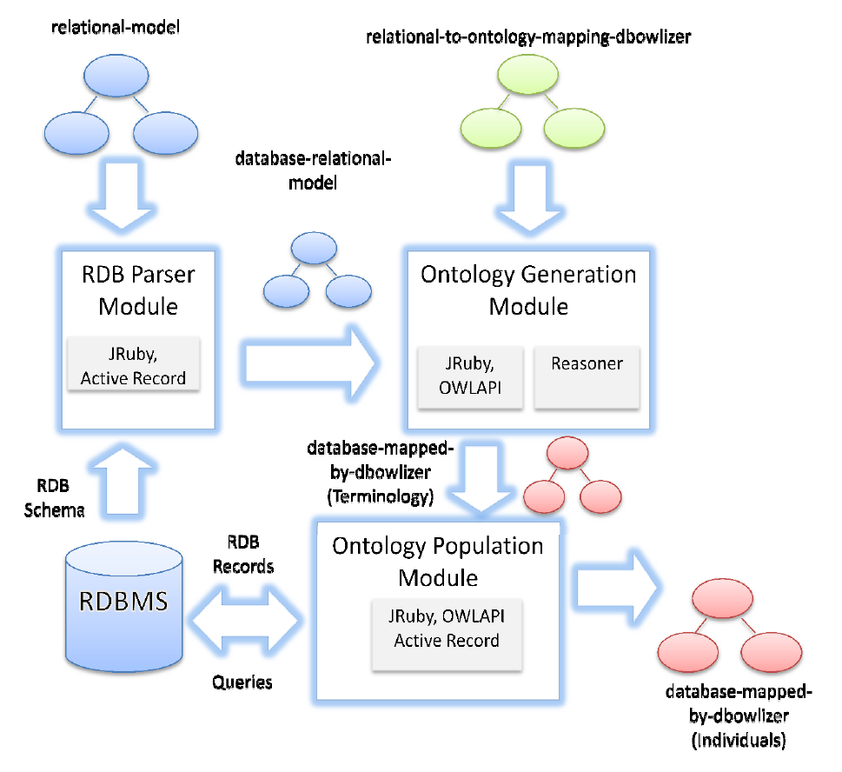

Slide 9
Parsing Data
Analyzing current structure of data
Reading the data
Processing the data into a more useful in-memory format

Slide 10
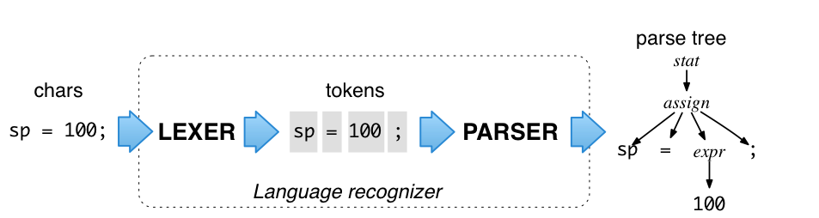
AntlrV4

Slide 11
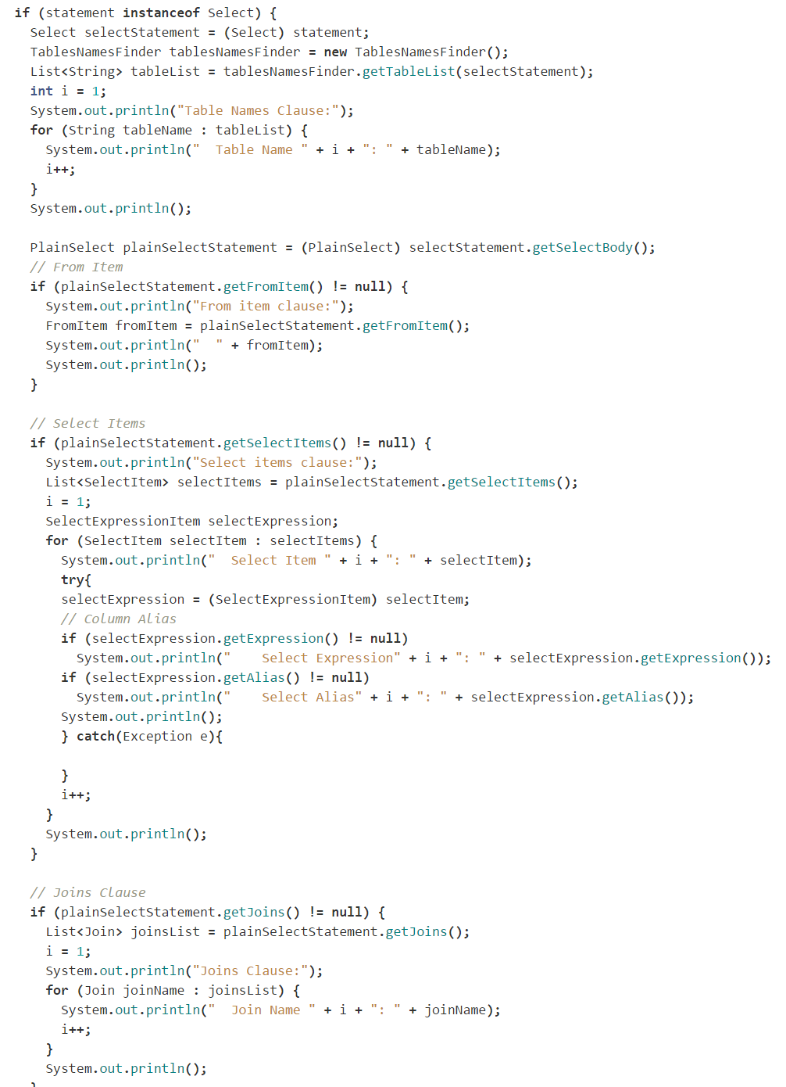
JSqlParser
A java SQL statement parser that uses the Visitor Pattern
TableNamesFinder.getTableList(selectStatement);
selectStatement.getJoins();
Notes:
The Visitor pattern represents an operation to be performed on the elements of an object structure without changing the classes on which it operates. This pattern can be observed in the operation of a taxi company. When a person calls a taxi company (accepting a visitor), the company dispatches a cab to the customer. Upon entering the taxi the customer, or Visitor, is no longer in control of his or her own transportation, the taxi (driver) is.

Slide 12
References
MaterializeCss - http://materializecss.com/
Template 1 - http://materializecss.com/templates/starter-template/preview.html
Template 2 - http://materializecss.com/templates/parallax-template/preview.html
Formalizing Relational Databases as OWL Ontologies - https://goo.gl/uHMtWj
AntlrV4 - http://www.antlr.org/
JsqlParser - http://jsqlparser.sourceforge.net/

